Slide 1


GROUP A
GASKIN GREEN AUTOS
GROUP MEMBERS
SARA JAMIL
MANHA ABDELLAH
NEHA ALAM
SHEHLA ASGHAR
HAMZA ALI
CAPSTONE PROJECT 1

Slide 2
ABOUT GASKINS GREEN AUTOS
Gaskin green autos is a car manufacturing company that uses environment friendly technology.
The company has hired us to gather, analyze data and provide actionable recommendations.

Slide 3

OUR GOAL
To explore and analyze the data set at hand to identify potential opportunity and improvement areas.

Slide 4

OUR PLAN
PLAN
IDENTIFY STAKEHOLDER
GATHER DATA
PREPARE
CLEAN DATA
PREPARE DATA
PROCESS
RUN SQL QUERIES
RUN AND COMPILE QUERY RESULTS
ANALZYE
IDENTIFY PATTERN, TREND, PREDICTION OR ANAMOLY
PREPARE KEY TAKEAWAYS
SHARE
MAKE VISUALIZATIONS
SUGGEST RECOMMENDATIONS
ACT
IMPLEMENT RECOMMENDATION

Slide 5



OUR STAKEHOLDERS
Stake holder is any individual who might be interested in the analysis we have performed on our data set.
HR management
Automotive industry
Salesperson
The HR management will be interested to know how to enhance salesperson's' work and customer loyalty.
Gaskins Green autos' data help automotive business holders to understand and act on the given recommendations based on the visualization presented.
One of the most effective stakeholders to target and keep satisfied is the customer.
We have tried to predict what is impacting customer's behavior and affecting positive encounter percentage.

Slide 6
Relationship between Salary of customers and their credit score.
OUR BUSINESS PROBLEMS
Employee Retention : Its effects on sales.
Relationship between Payment method and Salary
Weekly Performance Analysis : Co-relation between sales and week of month.

Slide 7

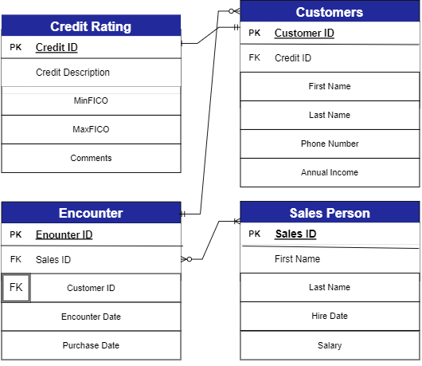
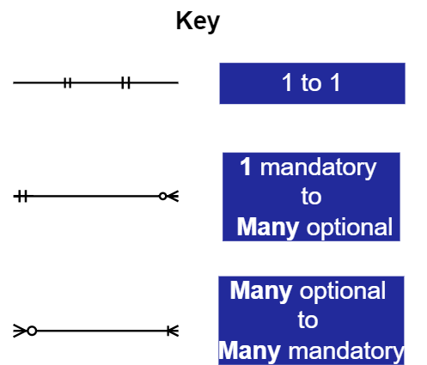
ERD

Slide 8
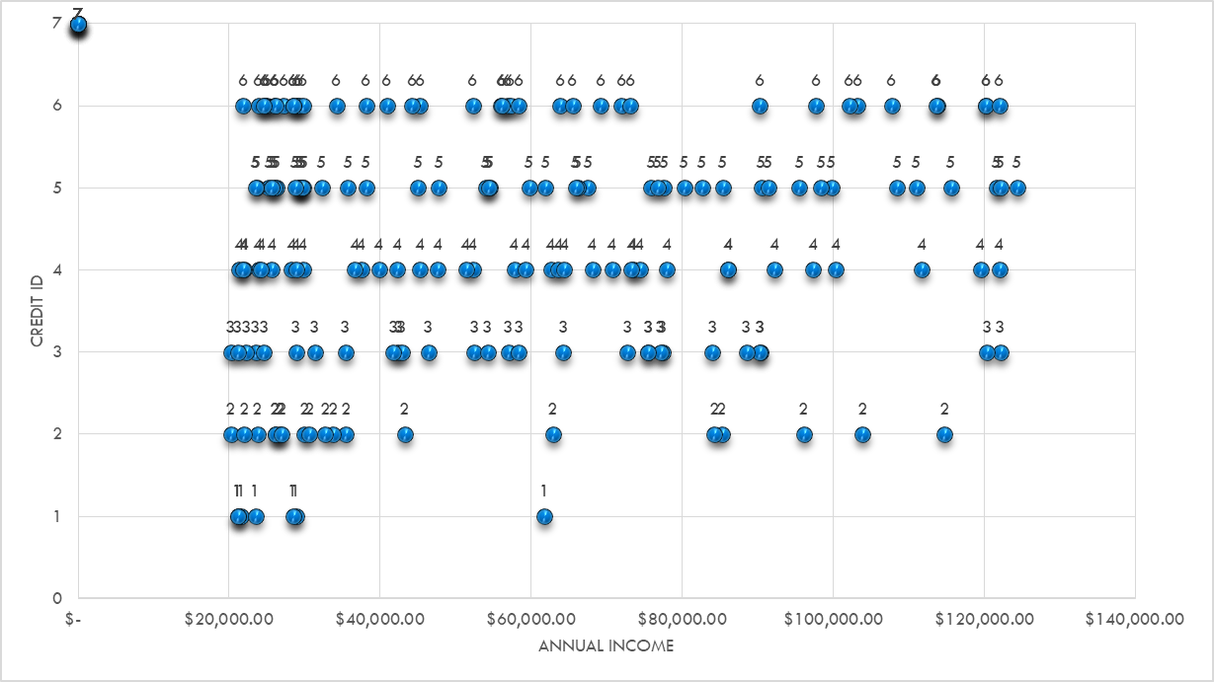
Relationship between Salary of customers and their credit score
Through this visualization we have tried to understand if their exists any relation between the income levels of a customer with their credit rating. The graphs elaborates how customers belonging to different income levels have the same credit ratings.

Slide 9
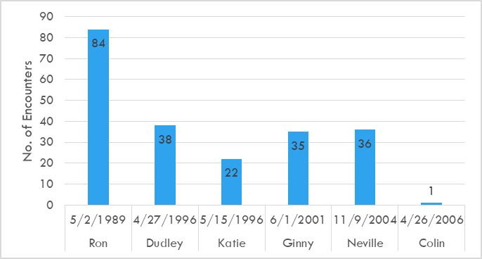
Employee Retention : Its effects on sales.
Protect your assets with a solid security management plan.
Through this graph we have displayed the salespersons and their number of encounters arranged in the ascending order of their hiring date. Our graph shows that experienced salesperson have higher number of encounters.

Slide 10
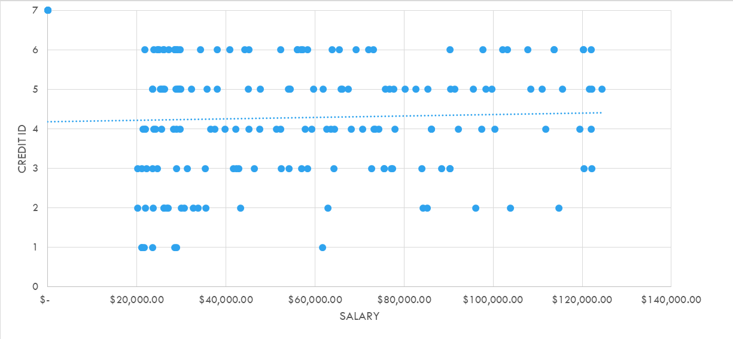
Relationship between Payment method and Salary
Protect your assets with a solid security management plan.
This graph tells us that customers with a certain range of income ...

Slide 11
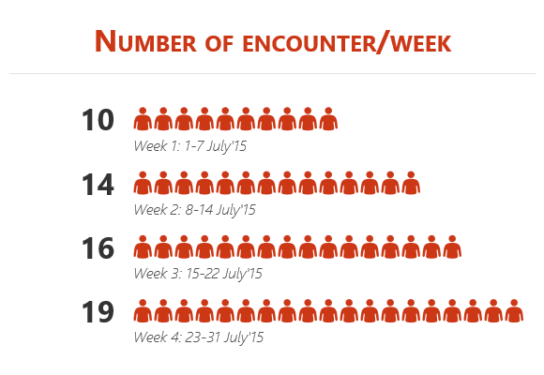
Weekly Performance Analysis: Co-relation between sales and week of month.
Protect your assets with a solid security management plan.
Through this graph we have identified a pattern of number of encounters increasing as we progress towards the end of the month. The beginning of the month having the lowest encounters and end being the most productive in terms of encounters.

Slide 12
OUR RECOMMENDATIONS
Looking at the analyzed data from the eyes of a data analyst we suggest the following;
Each customer is important
Salesperson experience
Weekly report
As per our results it is clear, the customer and their contribution to the company is made indifferent to what they earn or make monthly.
Treating every visitor has a potential customer will reap good results.
The more experienced your salesperson in working with you, the better their performance is going to be. Keeping them happy through bonus monetary incentives and good salary will retain them longer.
As the weeks pass each month, the average performance of all employees improved allowed for an increase number of encounter.

Slide 13


POSSIBLE COURSE OF ACTIONS
Training sessions between experienced salesperson with those new to field.
Add more responsibility to the highest salary taker yet lowest encounter percent.
Introduce salary levels for numbers of encounters met each month.
Bridge the gap between customers and salesperson by providing consultation sessions, free visits and etc.

Slide 14

Thank you,
we encourage any questions on board.

